Slide 1

تحليل البيانات باستخدام الاكسل – اليوم الثاني
إعداد و تقديم:
عبدالله العمير

Slide 2

Pivot Tables in Excel
Pivot tables are a powerful tool for analyzing and summarizing data in Excel. They allow you to quickly create dynamic tables and charts that can be filtered and sorted to reveal insights.

Slide 3

What are Pivot Tables?
1
Data Summarization
2
Interactive Exploration
Pivot tables are powerful tools in Excel that allow you to summarize and analyze large datasets.
They provide a dynamic way to explore your data by allowing you to filter, group, and aggregate information.
3
Data Visualization
4
Business Insights
Pivot tables can be used to create charts and graphs that visually represent your data.
They help you identify patterns, trends, and outliers in your data, leading to valuable insights for decision-making.

Slide 4




Benefits of using Pivot Tables
Faster Data Analysis
Improved Data Visualization
Enhanced Presentation
Increased Flexibility
Pivot tables can quickly summarize large datasets, reducing the time needed to analyze data and gain insights.
Pivot tables are highly flexible, allowing users to easily filter, sort, and group data to explore different perspectives.
Pivot tables can organize and present data in a clear and insightful way, making it easier to understand trends and patterns.
Pivot tables create professional-looking reports that can be easily shared with others, improving communication and collaboration.

Slide 5

Creating a Pivot Table
1
Select Your Data
Begin by selecting the range of data you want to analyze. This data can be from a single worksheet or multiple worksheets.
2
Insert Pivot Table
Navigate to the Insert tab and click on the PivotTable button. A dialogue box will appear, where you can choose to place the pivot table on a new worksheet or within the existing worksheet.
3
Drag and Drop Fields
The PivotTable Fields pane will appear, allowing you to drag and drop fields from your data source into the various areas of the pivot table: Rows, Columns, Values, and Filters.

Slide 6

Pivot Table Layouts
Pivot tables offer various layouts to organize your data in different ways.
Choose the layout that best suits your analysis needs, whether you want to compare values across rows or columns, or present a summarized view of data.

Slide 7

Pivot Table Filters
Filter Types
Data Reduction
Pivot tables offer various filter options: basic, advanced, and date filters. They allow you to refine your data based on specific criteria.
Filters help you focus on the most relevant data points by excluding unwanted information.
Dynamic Analysis
Interactive Exploration
Filters enable you to quickly experiment with different data scenarios and uncover insights.
Filters create interactive experiences for data exploration, allowing users to adjust data views on-the-fly.

Slide 8
Pivot Table Calculations
Custom Calculations
Built-in Functions
Pivot tables allow you to perform calculations beyond simple sums and averages. You can create custom formulas to calculate percentages, variances, and other derived metrics.
Excel provides a wide array of built-in functions for calculations within pivot tables.
Use functions like SUM, AVERAGE, COUNT, MAX, MIN, and more.
Create calculated fields to derive new values from existing data.

Slide 9
Pivot Table Grouping
Select Columns
1
Choose columns to group.
Group Levels
2
Define grouping levels.
Group Values
3
Assign values to each level.
Pivot Table grouping enables you to summarize data by grouping similar values together. For example, you can group dates into months, weeks, or quarters. Grouping helps you gain insights and make informed decisions based on aggregated data.

Slide 10





Pivot Table Sorting
Ascending Sort
Descending Sort
Sort data in ascending order, from smallest to largest.
Sort data in descending order, from largest to smallest.
Alphabetical Sort
Custom Sort
Sort data alphabetically, from A to Z.
Create a custom sort order based on specific criteria.

Slide 11
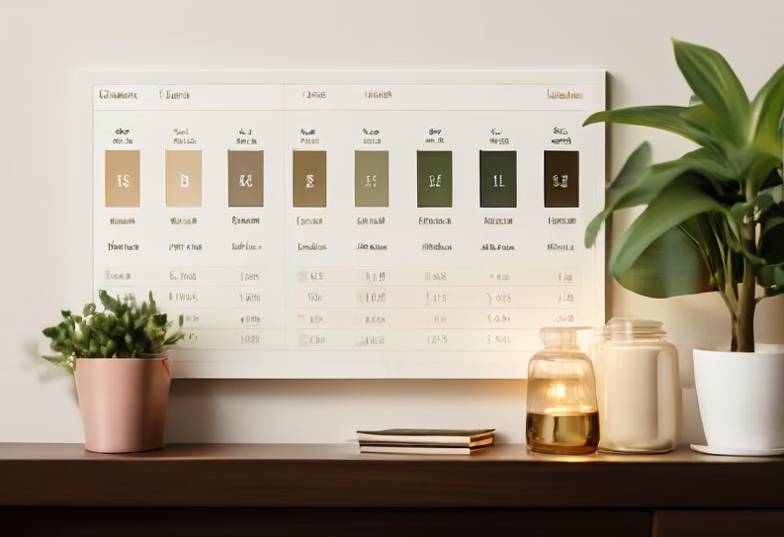
Pivot Table Formatting
You can apply various formatting options to improve the readability and appearance of your pivot tables. You can change the font, color, size, and alignment of text elements. You can also apply different styles to the rows, columns, and cells.
You can use conditional formatting to highlight specific values based on certain criteria. For example, you can make sales figures exceeding a target value appear in green.

Slide 12

Pivot Table Conditional Formatting
1
1. Highlight Significant Data
2
2. Visual Cues
It uses colors, patterns, and icons to make data easier to interpret.
Conditional formatting emphasizes data points that meet certain criteria.
3
3. Data Analysis
4
4. Customizable Rules
It helps to quickly identify trends, outliers, and anomalies.
You can set rules based on values, dates, or even rankings.

Slide 13



Pivot Table Slicers
Interactive Filtering
Multiple Slicers
Enhanced Analysis
Slicers allow you to filter data in a pivot table by clicking on values in the slicer control. They provide a visual and interactive way to explore your data.
You can add multiple slicers to a pivot table to filter by various dimensions of your data. This gives you powerful analysis capabilities.
Slicers enable you to quickly and easily change the data displayed in your pivot table, allowing you to perform insightful analysis.

Slide 14

Pivot Table Timelines
Visualizing Trends
Filtering and Grouping
Interactive Exploration
Timelines provide a clear visual representation of data over a period of time, revealing trends, patterns, and seasonal variations.
You can filter and group data by specific time intervals, such as months, quarters, or years, to analyze specific time periods.
Timelines are interactive, allowing you to easily navigate through time and explore data at different levels of detail.

Slide 15

Pivot Table Charts
Pivot Table Charts are a powerful feature in Excel, enabling the creation of dynamic and insightful visualizations based on the data summarized in a Pivot Table. They offer a visual representation of the data, making it easier to understand trends, patterns, and relationships within the data.
These charts are interactive, responding to changes made to the Pivot Table, such as filtering or sorting the data. This interactivity allows for on-the-fly analysis and exploration of the data.

Slide 16





Pivot Table Drill-Down
Drill Down
Pivot tables offer drill-down functionality to explore data in detail.
Expand and Collapse
Click on a data point to expand or collapse its subcategories.
Analyze Deeper
Drill down into specific segments of your data to uncover insights.
Uncover Trends
Investigate individual data points to identify patterns and trends.

Slide 17
Pivot Table Refreshing
Automatic Refresh
Manual Refresh
Pivot tables can automatically refresh when the source data changes. This ensures that your analysis is always up-to-date.
You can manually refresh a pivot table by clicking the 'Refresh' button in the PivotTable Analyze tab.
Select the pivot table.
Enable the 'Refresh Data' option in the PivotTable Options.
Go to the 'Analyze' tab.
Click the 'Refresh' button.
Set a refresh interval to specify how often the pivot table should update.

Slide 18




Pivot Table Updating
Data Refresh
Pivot tables automatically update when the source data changes.
Manual Refresh
You can manually refresh a pivot table to ensure you're seeing the latest data.
Scheduled Refresh
You can schedule regular updates for your pivot tables.

Slide 19
Introduction to Pivot Charts
Pivot charts are a powerful and dynamic way to visualize data in Excel. They are a type of chart that is automatically linked to a pivot table, so any changes made to the pivot table will be reflected in the chart. This makes it easy to explore and analyze your data in a visual way.

Slide 20

Pivot Chart Types
1
1. Column Chart
2
2. Bar Chart
Column charts display data vertically, ideal for comparing values across categories.
Bar charts display data horizontally, best for comparing values within a category.
3
3. Line Chart
4
4. Pie Chart
Line charts show trends over time, useful for analyzing data over a period.
Pie charts represent parts of a whole, useful for displaying proportions.

Slide 21




Pivot Chart Formatting
Chart Colors
Chart Title
Customize chart colors to improve visual appeal and clarity. Use a color palette that complements the data and enhances presentation.
Add a clear and concise title to the chart. The title should accurately represent the chart's content and purpose.
Axis Labels
Chart Legend
Label the chart's axes with descriptive and clear labels. Make sure the labels are easy to read and understand.
Use a legend to explain the different data series represented in the chart. The legend should be clearly visible and easily understandable.

Slide 22
Pivot Chart Filtering
Slicers
Filters
Slicers are interactive controls that allow you to filter your pivot chart data. They make it easy to quickly change the data displayed.
Pivot charts have built-in filters that you can use to refine the data displayed.
Click on the filter icon in the chart.
Drag and drop slicers onto your chart.
Select the filter criteria you want to apply.
Click on slicer values to filter data.

Slide 23

Pivot Chart Interactivity
Data Exploration
Explore data in a dynamic way. Filter or slice your data, and the chart updates in real time.
Trend Identification
Observe relationships and trends in your data. Pivot charts make it easy to see patterns.
Insights and Decisions
Interact with the chart to gain new insights, and make data-driven decisions.

Slide 24

Introduction to VLOOKUP
VLOOKUP is a powerful function in Excel. It helps you find specific data within a table or range of cells. You can use it to search for information across columns.

Slide 25

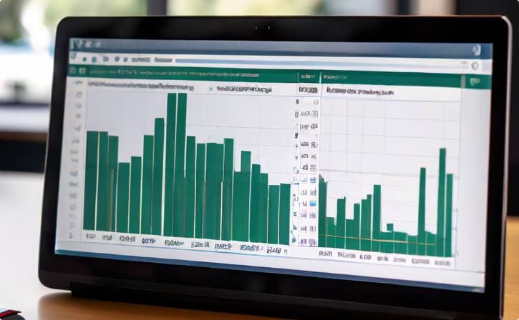
VLOOKUP Syntax
VLOOKUP Structure
Argument Details
The VLOOKUP function has four main arguments: the lookup value, the table array, the col_index_num, and the range_lookup.
The lookup value is the data you want to find, the table array is the range containing the data, col_index_num is the column number in the table array containing the result, and range_lookup is a logical value that determines whether an exact or approximate match is required.

Slide 26

VLOOKUP Examples
Employee Data Lookup
Imagine a spreadsheet with employee names and their corresponding salaries. You can use VLOOKUP to quickly find an employee's salary based on their name.
Product Price Lookup
In a product catalog, VLOOKUP can be used to find the price of a specific product based on its unique identifier, such as a product code.
Customer Information Lookup
VLOOKUP allows you to retrieve customer information, such as their address or phone number, based on their customer ID or email address.

Slide 27
VLOOKUP Troubleshooting
1
1. #REF! Error
2
2. #N/A Error
The #REF! error indicates a reference error, which occurs when a formula refers to a cell that no longer exists. Ensure that the lookup value is in the first column of the lookup range and that the lookup range is correctly specified.
The #N/A error signifies that the lookup value was not found in the lookup range. Check the spelling and formatting of the lookup value to ensure it matches the data in the lookup range.
3
3. Incorrect Data Type
4
4. Range Lookup
Ensure that the lookup value and the data in the lookup range are of the same data type. If they are different, VLOOKUP may return incorrect results.
VLOOKUP uses range lookup by default, meaning it will find the closest match to the lookup value. If an exact match is required, set the fourth argument of VLOOKUP to FALSE.

Slide 28

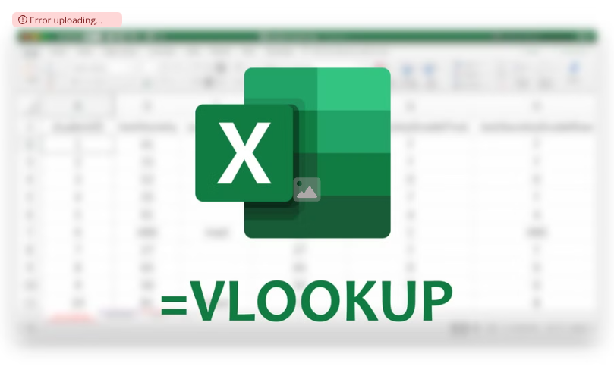
VLOOKUP vs. HLOOKUP
Error uploading image.
VLOOKUP
HLOOKUP
VLOOKUP searches for a value in the first column of a table and returns a corresponding value from a specified column.
HLOOKUP searches for a value in the first row of a table and returns a corresponding value from a specified row.

Slide 29





VLOOKUP vs. INDEX/MATCH
Performance
Flexibility
INDEX/MATCH is typically faster, especially with large datasets.
INDEX/MATCH offers greater flexibility in handling multiple lookup criteria.
Complexity
Universality
VLOOKUP is simpler to understand and implement, but INDEX/MATCH is more powerful.
Both functions are widely used and supported across various spreadsheets.

Slide 30
VLOOKUP Best Practices
Data Organization
Lookup Value Accuracy
Maintain a consistent structure for your data. Avoid unnecessary spaces or special characters, which can lead to errors. This allows for accurate and efficient VLOOKUP operations.
Ensure the lookup value is correctly formatted and matches the corresponding data in the lookup table. This includes case sensitivity, leading or trailing spaces, and consistent data types.

Slide 31

Conclusion and Key Takeaways
Mastering Excel Power Tools
Pivot tables and charts are incredibly powerful tools for analyzing and visualizing data. VLOOKUP is an essential function for looking up and retrieving information from tables.
Increased Productivity & Insight
By leveraging these tools, you can streamline your data analysis workflow, gain valuable insights, and make data-driven decisions.
Further Exploration
Continue exploring advanced features and techniques to maximize your proficiency with Excel and unlock its full potential.

